Slide 1
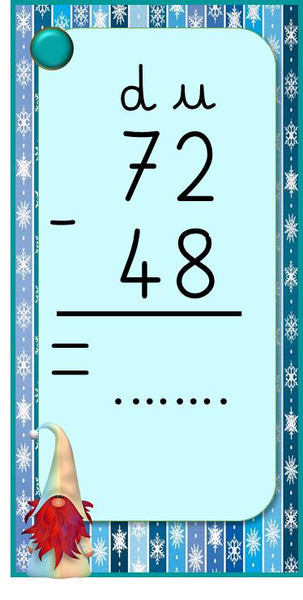
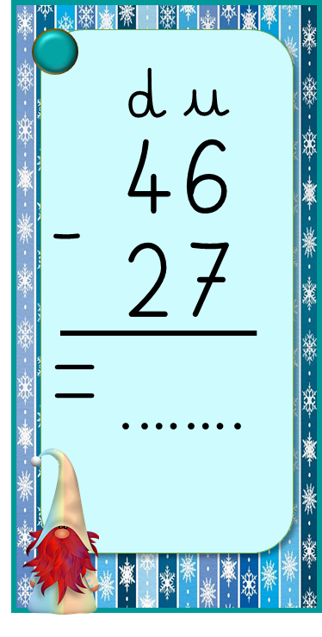
d
u
d
u
d
u
d
u
d
u
41
26
37
18
83
16
58
29
46
27
-
-
-
-
-
=
=
=
=
=
.…….
.…….
.…….
.…….
.…….
ReCreatisse.com
ReCreatisse.com
Notes:
1

Slide 2
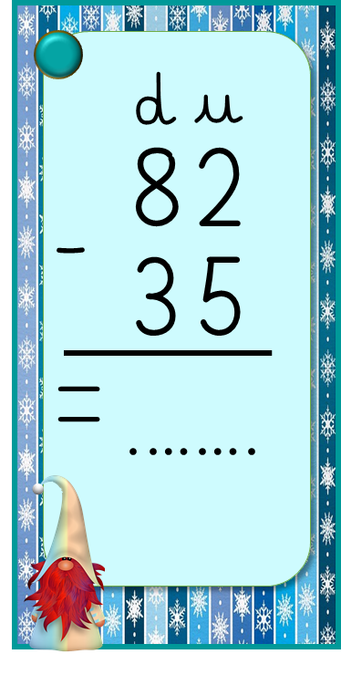
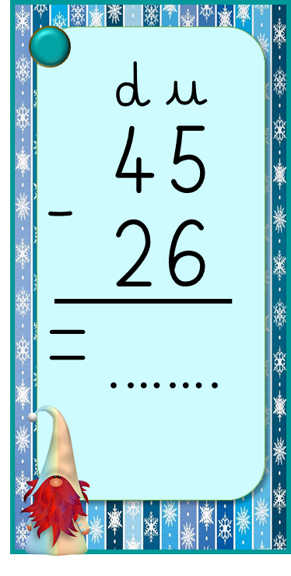
d
u
d
u
d
u
d
u
d
u
74
36
87
69
92
25
71
32
45
26
-
-
-
-
-
=
=
=
=
=
.…….
.…….
.…….
.…….
.…….
ReCreatisse.com
ReCreatisse.com
Notes:
1

Slide 3
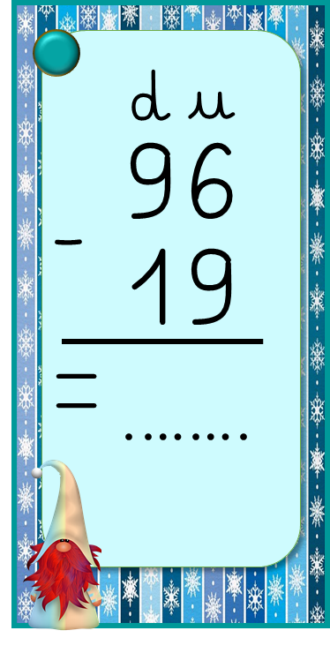
d
u
d
u
d
u
d
u
d
u
68
23
90
42
75
36
84
57
43
37
-
-
-
-
-
=
=
=
=
=
.…….
.…….
.…….
.…….
.…….
ReCreatisse.com
ReCreatisse.com
Notes:
1

Slide 4
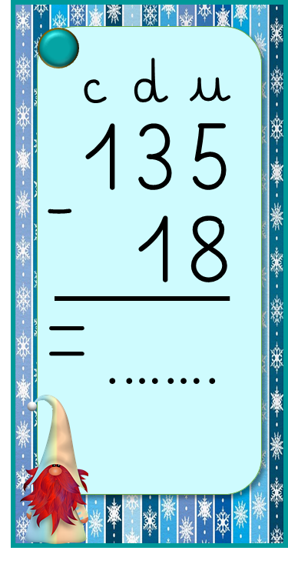
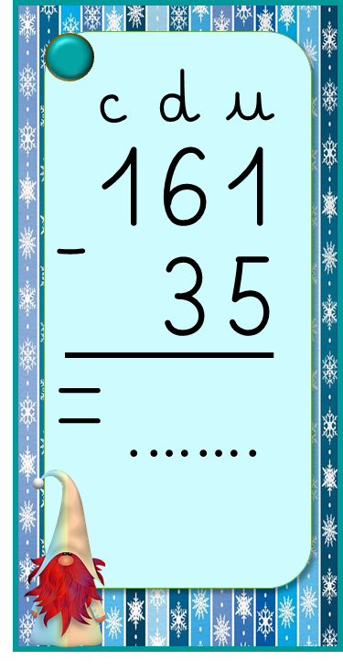
c
d
u
c
d
u
c
d
u
c
d
u
c
d
u
145
23
157
49
133
25
164
43
161
35
-
-
-
-
-
=
=
=
=
=
.…….
.…….
.…….
.…….
.…….
ReCreatisse.com
ReCreatisse.com
ReCreatisse.com
ReCreatisse.com
Notes:
d

Slide 5
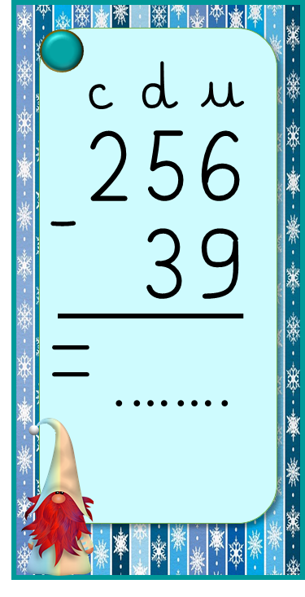
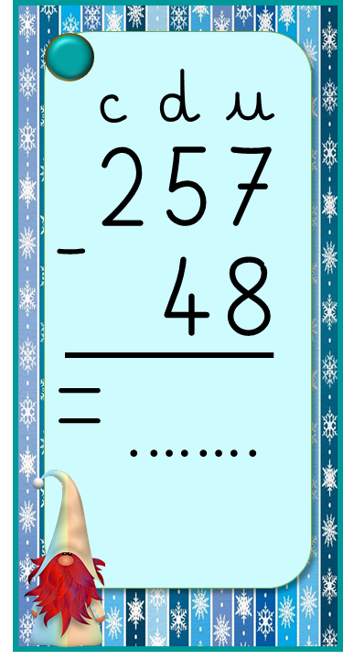
c
d
u
c
d
u
c
d
u
c
d
u
c
d
u
273
46
282
74
264
58
290
73
257
48
-
-
-
-
-
=
=
=
=
=
.…….
.…….
.…….
.…….
.…….
ReCreatisse.com
ReCreatisse.com
ReCreatisse.com
ReCreatisse.com
Notes:
d

Slide 6
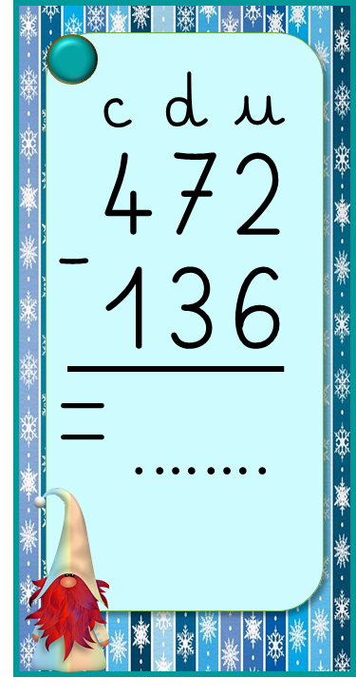
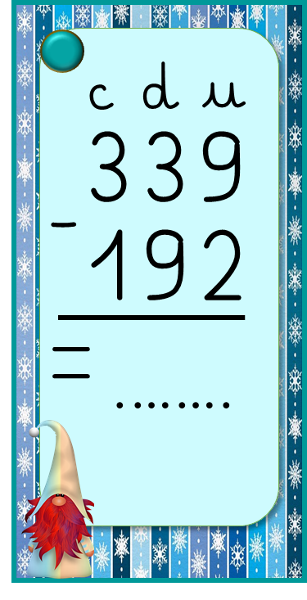
c
d
u
c
d
u
c
d
u
c
d
u
c
d
u
251
137
343
172
238
164
446
154
339
192
-
-
-
-
-
=
=
=
=
=
.…….
.…….
.…….
.…….
.…….
ReCreatisse.com
ReCreatisse.com
ReCreatisse.com
ReCreatisse.com
Notes:
d

